Slide 1
OPIOID USE DISORDERS MEDICATION ASSISTED TREATMENT Presentation to the Treatment and Recovery Subcommittee
SUBSTANCE USE RESPONSE GROUP
Lesley Dickson, MD
Medical Director, BEHAVIORAL HEALTH GROUP
(Formerly Center for Behavioral Health)
ADJUNCT Professor of Psychiatry
Touro University
PAST-PRESIDENT, Nevada Psychiatric Association

Slide 2
Dr. Dickson has no Financial Arrangements to Disclose

Slide 3
Opioid Use Disorder

Slide 4
Opioid Use Disorder
Opioid use leading to impairment or distress, with at least two of the following occurring within a 12-month period:
Opioids used in larger amounts or over longer period than intended
Unsuccessful efforts to cut down or control use
Much time spent obtaining, using or recovering from opioids
Craving or strong desire to use opioids
Failure to fulfill major role obligations at work, school or home
Continued use despite social or interpersonal problems
Important social, occupational or recreational activities are given up or reduced

Slide 5
Opioid Use Disorder
Recurrent use in situations where it is physically hazardous
Continued opioid use in spite of persistent physical or psychological problem
10. Tolerance: the need for increased amounts for the desired effect or diminished effect of same amount
11. Withdrawal: a characteristic syndrome of symptoms with the same or closely related substance taken to avoid or relieve withdrawal symptoms

Slide 6
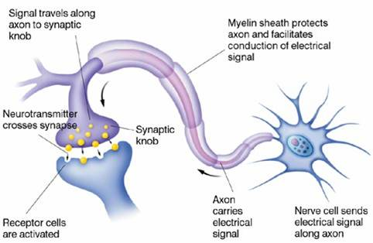
Neurotransmission

Slide 7
The synapse

Slide 8
Brief History of Opioids
Use found as far back as 3400 BC “joy plant” Papaver somniferum
Opioids used to control coughing, diarrhea and pain, primarily oral
1600’s opium smoking spread around the world, including America
1806 isolation of morphine, named after Morpheus, Greek god of dreams and sleep
By 1820, commercially available around the world
1853 syringe perfected allowing parenteral delivery of morphine
Heroin discovered in 1874 – synthesized from morphine
Opiates – naturally occurring substances in raw opium and
include morphine, codeine, papaverine and thebaine

Slide 9
History of Opioid Use Disorder
1830-1899: extracts of opium such as laudanum were common and used to treat food poisoning and GI problems and were valued for their sedating and calming effects
Tended to be white, middle-class females who became addicted while self-medicating – “sickly” or neurasthenic
Civil War veterans and Chinese immigrants both had problems with overuse
Dangers of use recognized in late 1800’s
1900-1914 Morphine Maintenance Clinics
1914 Harrison Narcotics Tax Act: established the FDA and a federal system for regulation of drug manufacturing, pharmacies and physician prescribing
Became illegal to treat OUD with prescribed opioids – 3000 physicians were jailed!

Slide 10
History of OUD Treatment
With the Harrison Act, OUD problems were shifted to criminal justice system
Introduction of heroin worsened the situation and there were several heroin epidemics after the wars of the 20th century
1960 Vincent Dole and wife Marie Nyswander published on efficacy of methadone maintenance
1972 FDA issued federal methadone regulations, thereby legalizing methadone maintenance treatment
Never caught on with most users and the medical community
Heroin misuse remained the predominant opioid problem until the mid 1990’s when pain pill misuse increased

Slide 11
Opioid Mechanisms
Opioids are molecules which circulate in the blood and enter the central nervous system (primarily brain and spinal cord)
All opioids bind to three receptors, μ, δ and κ
Most clinical effects come from binding at the μ (mu) receptor in the brain
Endogenous (self-made) opioids include the β-endorphins, enkephalins and dynorphins
Opiates are compounds derived or synthesized from the natural product thebaine and its derivatives isolated from the opium poppy plant

Slide 12
Exogenous (from outside) opioids lead to rapid receptor desensitization and tolerance and withdrawal
Tolerance is the need for increasing amounts to get the same effect
Withdrawal is an array of unpleasant symptoms when the drug is reduced or stopped
Opioids are medically used for relief of pain and cough suppression and all have an abuse potential

Slide 13
Fentanyl
Very potent synthetic opioid
Huge threat and linked to many recent accidental deaths
Produced in Mexico and China – often mixed with heroin
Analogs such acetyl fentanyl, furanyl fentanyl and carfentanil (veterinary use) also out there, Schedule I drugs
Fentanyl, Schedule II, used in anesthesia and for post-op pain
Also used for severe cancer pain when other opioids no longer effective – available as a long-acting transdermal (skin) patch and in lozenges or lollipops
It is being added to amphetamines, opioid pills and benzodiazepines

Slide 14
Opioid Agonist Effects
Acute Use Effects: Euphoria, Vomiting, Constricted Pupils, Slowed respirations, Drowsiness, Analgesia, Decreased awareness, Altered consciousness
Chronic Use Effects: Physical dependence, Psychological dependence, Variable energy changes, Constipation
Overdose Effects: Nonresponsive, Pinpoint pupils or “blown” pupils, Bradycardia, Hypotension, Skin cyanotic (blue-gray), Muscles flaccid, Pulmonary edema, Slowed respirations

Slide 15
Opioid Withdrawal
Cessation or reduction in opioid use or administration of an opioid antagonist after a period of opioid use
Three or more of the following:
Dysphoric mood Diarrhea
Nausea or vomiting Yawning
Muscle aches Fever
Lacrimation (tears) Rhinorrhea (drippy nose)
Pupillary dilation Piloerection (goose bumps)
Sweating Insomnia
Symptoms cause significant distress or impairment
Symptoms not due to a medical or other mental condition

Slide 16
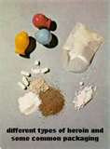

Slide 17
The μ Receptor in Normal Physiology
Neuroendocrine function including the HPA axis and Reproductive
Immunological function
Gastrointestinal function
Cardiovascular function
Pulmonary function and respiratory drive
Endogenous response to pain
Mood, affect, cognition

Slide 18
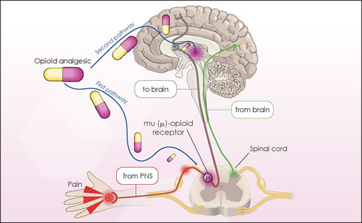
Pain and the Mu Receptor

Slide 19
Medical Complications of Opioid Dependence
Infections, primarily from injecting
Hepatitis B, C and delta
Cellulitis and abscesses
HIV and STD’s
Endocrine, primarily reproductive
Gastrointestinal, primarily constipation
Liver disease, primarily from viral infections
Respiratory depression and accidental overdose death
Trauma from accidents, violence, sexual abuse
Depression and suicide

Slide 20
Reversal of Overdose: Naloxone
Pure mu receptor short-acting antagonist – brand name is Narcan
Used for overdoses but timing is essential
Brain death starts in 4-8 minutes after breathing stopped
Not available for oral use
Injectable solution, nasal spray and one-dose administered injection
Now available for families, friends and rescue personnel
Laws now protect those who call to report overdose

Slide 21
Pain in the United States
Approximately 30% of Americans have pain
Older adults: 40%
Opioids are most prescribed class of medications in the U.S.
About 80% of world opioid use is in USA
2014: 245 million prescriptions for opioids
65% for short term (less than 3 weeks use)
3-4% of population (9-11.5 million) receive chronic opioid therapy

Slide 22
Misuse and Diversion
Opioids are important analgesics for acute pain
Less evidence for effectiveness in chronic pain
Increases in misuse and diversion have tracked with increased prescribing
Mu receptors are widespread in the brain: pain perception, emotional response to pain, pleasure, respiratory depression
Safety issues and adverse events including overdose, death, and addiction

Slide 23
Abstinence Based and Psychosocial Treatments
Inpatient detox and rehabilitation
Intensive Outpatient Treatment (IOP)
12 Step Programs
Counseling, particularly Cognitive Behavior based
Mindfulness becoming popular
Family therapy
Sober Living Residences
Nowhere near enough!

Slide 24
Medication Assisted Treatments (MAT) for Opioid Use Disorder
Short-Term:
Medical Withdrawal (Detoxification)
Opioid and non-opioid
Long-Term
Opioid antagonist
Opioid agonist or partial agonist

Slide 25
Opiate Withdrawal
Time to onset depends on how long the opioid is present
When used for pain for a period of time, withdraw gradually by tapering dose – difficult for patient to do
Most signs and symptoms abate in 48-96 hours after stopping opioids but some persist for months
Withdrawal is so unpleasant for many that they relapse to use, thus referral to MAT is an important option
Methadone and buprenorphine work well for detoxing with supervision

Slide 26
Opiate Substitution = Medication Assisted Treatment (MAT)
Methadone and Buprenorphine
Goals are to reduce or prevent the adverse effects of drug use and improve functioning, quality of life and overall functioning
Continual, regular use prevents periods of intoxication alternating with withdrawal and the need to be looking for the next dose
Should be partnered with rehabilitation services and supportive counseling, individual or group

Slide 27
Methadone
A synthetic, long acting, orally available μ and δ agonist – approved in 1964
Rapidly and nearly completely absorbed in GI tract
Peak plasma levels in 2-6 hours
Gives some euphoria
Plasma half-life about 24 hours so can dose daily
Can cause respiratory depression
Many overdoses and deaths due to methadone so closely monitored
Done in Federally certified programs with frequent inspections

Slide 28
Methadone: Program Management
Effective dosages between 60 and 120mg a day
Initially daily dosing in clinic, comes in liquid form
Start about 30mg and increase to lack of withdrawal and cravings
Programs need policies for illicit use
Expect relapses and support return to program
Programs should have counseling components
Reward clean urines and other positive behaviors
Earn privilege of take-home doses

Slide 29
Methadone: Chronic Use
Demonstrated safety and efficacy when used in a monitored program
No long-term damage to organ systems
Constipation common - treat actively
Relatively inexpensive and most programs take Medicaid
Non-Medicaid patients pay cash
Methadone is not reported on PDMP
Daily dosing is difficult for some patients

Slide 30
Buprenorphine: Unique in Opioid Use Disorders MAT
Buprenorphine first drug approved for office-based treatment of opioid addiction
Available by prescription – Schedule III
Up to 30-day prescription may be given – avoid refills
Physicians with specific training and DEA waiver can prescribe
Number of patients originally limited to 100 but recently increased to 275

Slide 31
Buprenorphine continued
Most insurance no longer requires a prior authorization but usually granted, expensive if cash pay
May need to become a Medicaid provider
Avoid sedatives such as benzodiazepines - check PDMP
Methadone clinics now prescribing or dispensing
APRN’s and Physician Assistants can now get “waivered” after a 24-hour course
DEA tracks prescribing and visits offices to assess compliance with regulations

Slide 32
Buprenorphine
Buprenorphine is a mixed μ receptor agonist / antagonist
Binds tightly to the μ receptor
Antagonist properties displace other opioids
Effectively blocks the effects of other opiates and therefore the reward qualities
Like methadone, is long-acting and safe
Can precipitate withdrawal reaction if given too soon after use of an opioid agonist
Must be in withdrawal or detoxed to start
Patients report little cravings or relapses, no “high”

Slide 33
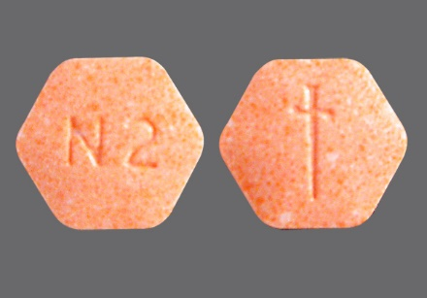
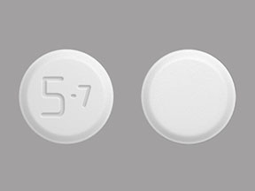
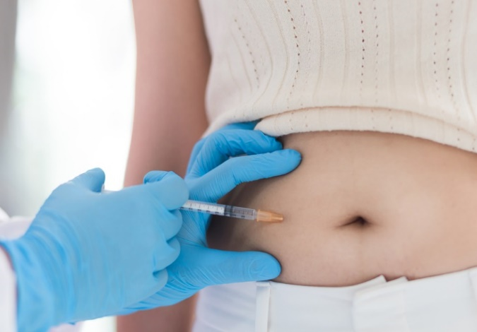
Buprenorphine Preparations

Slide 34
Buprenorphine Preparations
Available now in sublingual tablet and rapidly dissolving film, now 5 generic films
Used for detox and maintenance
Starting dose usually 8 to 16mg SL daily, can divide dose
Tablets and film can also contain naloxone in 4:1 ratio to reduce risk of abuse by injection (Suboxone, Zubsolv)
6-month implant available
Long-acting, 30-day, injection recently approved (Sublocade)
Tablet with only buprenorphine (Subutex) available for pregnant women
Must use sublingually – inactivated by acid in stomach

Slide 35
Buprenorphine vs. Withdrawal and Drug-Free Treatment for Heroin Dependence Kakko, Lancet 2003
20
15
Remaining in treatment (nr)
10
4 Subjects in Control Group Died
5
Detoxification
Maintenance
0
0
50
100
150
200
250
300
350
Treatment duration (days)

Slide 36
Opioid Antagonist: Naltrexone
Binds tightly to the μ (mu) receptor
Prevents other opioids from binding
Patients lose interest in using and no craving
Naltrexone tablet 50 mg/day (Revia) approved in 1994
Efficacy is best among motivated patients
Nausea, headache, anxiety or sedation are uncommon
side effects
Cannot be prescribed in patients with severe liver disease

Slide 37
Naltrexone continued
Depot (IM shot) Naltrexone (Vivitrol), 380 mg once a month, originally approved for alcohol use disorder
Recently approved for opioid use disorder and may enhance compliance
Depot shot expensive but some insurance and Medicaid covers
Efforts being made for use in those leaving a detox program, jail or prison to decrease risk of relapse
Important to warn a recently detoxed person that tolerance has decreased and to use a smaller dose if relapses

Slide 38
www.samhsa.gov/medication-assisted-treatment/physicianlocator www.suboxone.com/treatment-plan/find-a-doctor

Slide 39
Bridge Program
Modeled on California and Connecticut (Yale)* programs
To encourage emergency room staff to start buprenorphine in the ER and then refer to outpatient treatment
Requires ER staff to recognize and counsel patient
Will include a peer support recovery specialist or community health worker to be available to do the initial counseling and referral
ER docs will need to be waivered or at least educated in the dosing of buprenorphine
Working on eliminating the waiver requirement
Need hospitals to get on board and have buprenorphine on the formulary
* Emergency Department-Initiated Buprenorphine/Naloxone Treatment for Opioid Dependence: A Randomized Clinical Trial, G. D’Onofrio et al, JAMA. 2015;313(16): 1636-1644.

Slide 41
Candidates for Naltrexone
Patients who are not interested or able to be on agonist maintenance
Highly motivated for abstinence from all opioids (e.g., active in 12-step programs)
In professions where treatment with agonist is still controversial (e.g., healthcare professionals, pilots)
Patients who are detoxified and abstinent but at risk for relapse
Released from a controlled setting (prison, residential program)
Moving back to old neighborhood
With increased stress or worsening of psychiatric problems

Slide 42
Patients who may be better candidates for agonists
Patients with history of overdoses, particularly following detoxification
Patients with serious psychiatric or medical problems
Patients with limited social supports (unstable lives, homeless)
Patients who have been opiate-free but never felt “normal”
Patients in whom psychiatric illness emerged/worsened after previous detoxifications (with or w/o naltrexone)
Patients with chronic pain requiring chronic opioid treatment
Patients with severe GI disorders exacerbating during withdrawal/abstinence

Slide 43
Prescription Monitoring Program - PMP
Register or check a patient at https://Nevada.pmpaware.net
Nevada established in 1997 – one of the first states
All states now have them
States with stronger mandates for use of PMP have decreased prescribing of opioids and overdose deaths
Can register a delegate in office to pull the reports
Can look at own prescribing history to check for fraudulent prescribing
Network between states – Nevada can check 23 other states, unfortunately not California

Slide 44
Governor’s Opioid Bill AB474
Overdoses from controlled substances must be reported
PMP must be consulted
Patient must be evaluated for history or risk of addiction
Must use consent form
2 hours of CME relating to the misuse and abuse of controlled substances, the prescribing of opioids or addiction during each relicensure period.
Good history and physical must be performed and entered into medical record along with diagnosis and treatment plan

Slide 45
PRESCRIBING OPIOIDS for PAIN
Painkillers are prescribed for no more than 14 days for acute pain.
After 30 days of consecutive prescriptions, the doctor and patient must enter into a narcotic contract that lays out goals for treatment and gives consent to drug testing if necessary.
At 90 days, a doctor must offer up an “evidence-based diagnosis” — not something generic like a diagnosis of “lower back pain” — and must recheck the state’s Prescription Monitoring Program database
For any prescription exceeding 365 days, doctors must document their rationale for prescribing opioids for so long.

Slide 46
MAT and Pregnancy
Methadone has been the “Gold Standard”
Want to stabilize patient and prevent using and withdrawals – hard on the fetus
Provides for supervised prenatal care
May need to increase dose toward end of pregnancy
Buprenorphine now shown to be safe and effective although not FDA approved
Recent study used buprenorphine for Neonatal Abstinence Syndrome
Mother can breastfeed on either drug but watch timing of dosing and feeding

Slide 47
Neonatal Abstinence Syndrome - NAS
Opioids not good for baby: fetal growth restriction, Intrauterine withdrawal, depressed breathing, preterm delivery, premature rupture of membranes, perinatal death, NAS
NAS in 30% to 80% infants born to women taking opioids, including those in MAT programs
Disruption of mother-infant relationship, sleep-wake abnormalities, feeding difficulties, weight loss and seizures
Withdrawal symptoms include tremors, diarrhea, fever, irritability, jitteriness, sweating, vomiting, generalized convulsions
Opioids first-line therapy – methadone, buprenorphine and morphine

Slide 48
Methadone vs Buprenorphine in Pregnancy: Effects on Newborn

Slide 49
Kratom

Slide 50
Kratom II
Recreational drug in SE Asia and the West
55% of regular users become dependent
Implicated in some overdose deaths
Used in self-management of opioid withdrawal
Users tend to be middle-aged, male, white and employed
Small doses are stimulatory while larger doses have sedative-narcotic effect

Slide 51
Kratom III
Active drugs are mitragynine and 7-hydroxymitragynine
Binds to opioid receptors and several others (serotonin, noradrenaline and dopamine)
Mu partial agonist
Withdrawal similar to opioid withdrawal
Cravings and relapse
Presently unregulated or limited to over 18 or 21 in most states but banned in some
Working on changing to a Schedule I drug but push back from billion-dollar industry

Slide 52
Local resources
Inpatient/Detox Programs
WestCare 383-4044
Crossroads 702-433-4357
Seven Hills Behavioral Inst / Henderson 646-5000
Las Vegas Recovery Center (Landmark) 800-790-0091
Desert Hope Treatment Center 888-211-6274
Outpatient
Community Counseling 369-8700
Bridge Associates 474-6450
WestCare 702-385-2020
BHG Recovery (formerly Center for Behavioral Health) 702-796-0660
AA 598-1888
High Risk Pregnancy Center 702-940-3266
Several Methadone Programs – www.samhsa.gov/treatment

